Slide 1
Message Digest
Presented by
Shubham Kumar Choudhary

Slide 2
content
1. Message digest
1.1 Message digest diagram
2. Concept of Hash
2.1 Properties of Hash function
3. Advantages of a message digest
4. Requirement of a message digest

Slide 3
1. Message Digest
A message digests is a cryptographic hash function.
It containing a string of digits created by a one-way hashing formula.
They are designed to protect the integrity of a piece of data.
Message digest hash numbers represent specific files containing the protected works.

Slide 4
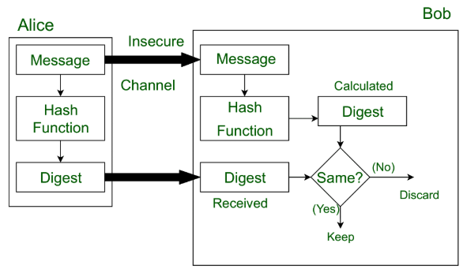
1.1 Message digest diagram

Slide 5
2.Concept of Hash (Message Digest)
The two most common hash functions are called MD5 and SHA-1.
MD5(Message Digest 5) produces a 120 –bits digest.
SHA-1(Secure Hash Algorithm 1) produces a 160-bits digest.

Slide 6
2.1 Properties of Hash function
MD5:
Hashing is one-way.
The digest can only be created from the message ,not vice versa.
SHA-1:
Hashing is a one-to-one function.
There is little probability that two message will create the same digest.

Slide 7
3. Advantages of a Message Digest
A message digest is used to turn input of arbitrary length into an output of fixed length.
The output can then be used in place of the original input.
The output always has the same length, so this can be taken into account when storing the message digest.

Slide 8
4.Requirement of A Message Digest
Given a message, it should be very easy to find its corresponding message digest.
Given a message digest, it should be very difficult to find the original message for which the digest was created.
Given any two messages, if we calculate their message digests, the two message digests must be different.

